Slide 1
XML, Schema, SOAP

Slide 2
API & Web Service Origins
A need for organizations and people to communicate and to share.
Started with commercial need for organizations to exchange business documents.
Early methods – EDI, B2B solutions, Value Added Networks.

Slide 3
Web Services
Web Services leveraged the ubiquity of the internet and the neutrality of XML.
Any platform that could generate/parse XML and connect to internet was web services capable.

Slide 4
Service Oriented Architecture (SOA)
SOA is a set of architectural principles.
Aims to build applications that can be consumed as services, in a platform- and protocol-independent way.
Rise of SOA coincided with that of Web Services.
Promotes service reuse.

Slide 5
Application Programming Interfaces (API)
The API concept predates personal computing and the web. This is as old as computing itself.
API is a publicly available entry point into a system, so the system’s functionality can be used.
In our context, APIs are ways of making payments and related services, available in an easy–to–use way.

Slide 6
APIs, Continued
Web APIs, just like Web Services, leverage the Internet.
Use well-known protocols, such as http and tcp.
Unlike Web Services, which were largely driven by commerce, web APIs were driven both by commerce and social media.

Slide 7
History of Web APIs
Use and adoption grew exponentially since 2000.
Commercial Adoption : eBay, Salesforce, Amazon
Social: Facebook, Instagram, Twitter
Has both coincided with and helped power the rise of cloud computing.

Slide 8
Web Services vs. APIs
Web Services are structured, supported by a large body of standards.
Well suited for exchange of business data.
Support for a variety of security needs, reliable messaging, asynchronous exchange.
Can get complex. Need specialized toolkits/clients.
Bar for adoption is high.

Slide 9
APIs vs. Web Services
APIs, by contrast grew from both commercial and social media needs.
Are easier to adopt.
Support a variety of languages.
Supports XML and JSON. JSON is lighter and is well-suited for Mobile devices.

Slide 10
Web APIs
Web APIs are simple to use, easy to experiment and work with.
Mobile apps use Web APIs to integrate with providers.
Simple and granular APIs make for better adoption. Give great freedom for app developers to use, so their needs are met.
Use RESTful interfaces.

Slide 11
REST
The adoption of REST as the predominant method to build public APIs has overshadowed any other API technology or approach in recent years. Although SOAP and other methods are still prevalent in the enterprise, early adopters of the API movement have opted for REST with JSON as their preferred message format:
SOAP/WSDL is overly complex in most cases and difficult to consume from thin clients.
The REST architectural style fits well with HTTP and the scalability, caching and distribution best practices prevalent in large-scale web and mobile applications.
The common use of JSON within REST APIs makes them extremely easy to consume from script-based platforms (web/Ajax, node.js, grails, etc.)

Slide 12
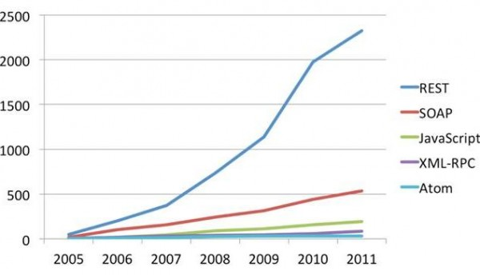
REST Adoption

Slide 13
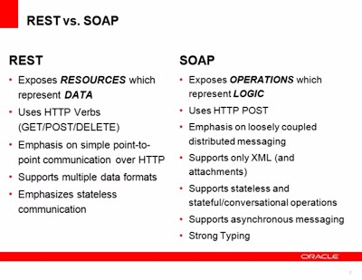
REST vs. SOAP

Slide 14
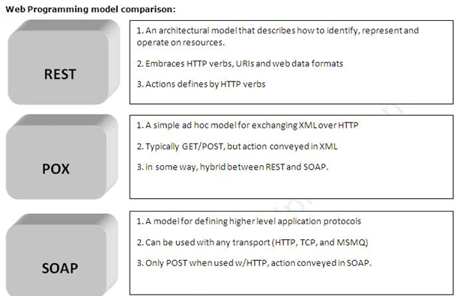
Web Programming Models

Slide 15
JSON
JSON- definition:
JavaScript Object Notation is a lightweight data-interchange format

Slide 16


JSON Model

Slide 17
JSON Example

Slide 18
XML

Slide 19
APIs & Web Services at Vantiv
We (EIS) see a need and use case for both APIs & Web Services.
Services designed based on principles of Service Orientation (SOA).
Propose to use Web Services for complex business use cases, eg., Boarding and Servicing Large Merchants, Research and Reporting.

Slide 20
APIs & Web Services at Vantiv
Encourage consumers to use RESTful APIs for simple use cases. Eg., Payments, Enquiry services.
Our approach is:
Design with Service Orientation. Expose as both RESTful APIs and Web Services.

Slide 21
Data Flow
Data flow through Cloud:
RAFT
Client
DataPower
Tier 1
webMethods
Tier 2
WebSphere Tier 2
DB2

Slide 22
Architecture
Active/Active architecture.
DataPower has 4 devices, 2 in each data center.
webMethods 9.5 has 4 devices, 2 in each data center.
WebSphere has 8 devices, 4 in each data center.

Slide 23
DataPower
Tier 1 device for authorization, authentication & audit of web services exposed to external clients.
Acting as a security gateway protecting against XML Injection and other attacks.
Performs schema validation to make sure request being sent is in proper format.

Slide 24
webMethods
Enterprise Service Bus (ESB) used for orchestration and mediation.
Is both a consumer and a provider. Provides services and consumes services on other platforms.
Supports wide variety of protocols, backend systems, databases and communication methods.
Supports synchronous and asynchronous communications.

Slide 25
WebSphere
Used mainly for low level and complex interactions, like socket communication with RAFT.
Complex DB interactions.
Applications developed in Java and related technologies.

Slide 26
XML
XML stands for Extensible Markup Language
Designed to describe data
Software and hardware independent
<note>
<to>Tove</to>
<from>Jani</from>
<heading>Reminder</heading>
<body>Don't forget me this weekend!</body>
</note>

Slide 27
Tags
With XML you invent the tags (like <to> and <from>) were invented by the author of the document
XML Simplifies Data Sharing
XML Simplifies Data Transport
Easy to Understand
Well structured, easy to read and write from programs

Slide 28
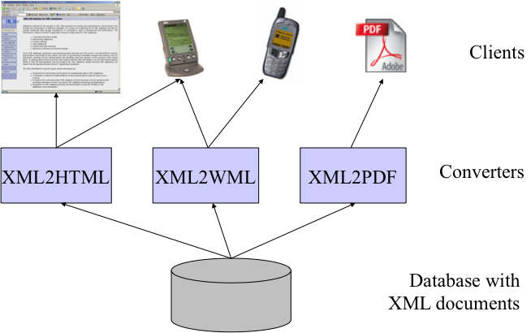
Content Management

Slide 29
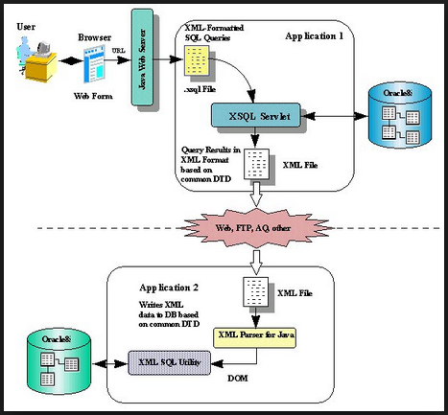
Data Exchange

Slide 30
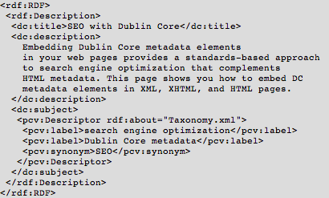
Meta Data
Notes:
The Resource Description Framework (RDF) is a family of World Wide Web Consortium (W3C) specifications [1] originally designed as a metadata data model. It has come to be used as a general method for conceptual description or modeling of information that is implemented in web resources, using a variety of syntax notations and data serialization formats. It is also used in knowledge management applications.

Slide 31
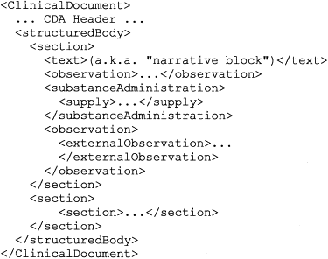
Document Markup
Add structural and semantic information to documents
Sections
Cross References
Citations
Index Entries
Notes:
The Resource Description Framework (RDF) is a family of World Wide Web Consortium (W3C) specifications [1] originally designed as a metadata data model. It has come to be used as a general method for conceptual description or modeling of information that is implemented in web resources, using a variety of syntax notations and data serialization formats. It is also used in knowledge management applications.

Slide 32
2.2 XML Documents
What‘s in an XML document?
Elements
Attributes
plus some other details (see the Lecture if you want to know this)

Slide 33
A Simple XML Document
<article>
<author>Gerhard Weikum</author>
<title>The Web in Ten Years</title>
<text>
<abstract>In order to evolve...</abstract>
<section number=“1” title=“Introduction”>
The <index>Web</index> provides the universal...
</section>
</text>
</article>

Slide 34
A Simple XML Document
Start Tag
<article>
<author>Gerhard Weikum</author>
<title>The Web in Ten Years</title>
<text>
<abstract>In order to evolve...</abstract>
<section number=“1” title=“Introduction”>
The <index>Web</index> provides the universal...
</section>
</text>
</article>
Content of the Element (Subelements and/or Text)
Element
End Tag

Slide 35
A Simple XML Document
<article>
<author>Gerhard Weikum</author>
<title>The Web in Ten Years</title>
<text>
<abstract>In order to evolve...</abstract>
<section number=“1” title=“Introduction”>
The <index>Web</index> provides the universal...
</section>
</text>
</article>
Attributes with name and value

Slide 36
Elements in XML Documents
(Freely definable) tags: article, title, author
with start tag: <article> etc.
and end tag: </article> etc.
Elements: <article> ... </article>
Elements have a name (article) and a content (...)
Elements may be nested.
Elements may be empty: <this_is_empty/>
Element content is typically parsed character data (PCDATA), i.e., strings with special characters, and/or nested elements (mixed content if both).
Each XML document has exactly one root element and forms a tree.
Elements with a common parent are ordered.

Slide 37
Elements vs. Attributes
Elements may have attributes (in the start tag) that have a name and
a value, e.g. <section number=“1“>.
What is the difference between elements and attributes?
Only one attribute with a given name per element (but an arbitrary number of subelements)
Attributes have no structure, simply strings (while elements can have subelements)
As a rule of thumb:
Content into elements
Metadata into attributes
Example:
<person born=“1912-06-23“ died=“1954-06-07“>
Alan Turing</person> proved that…

Slide 38
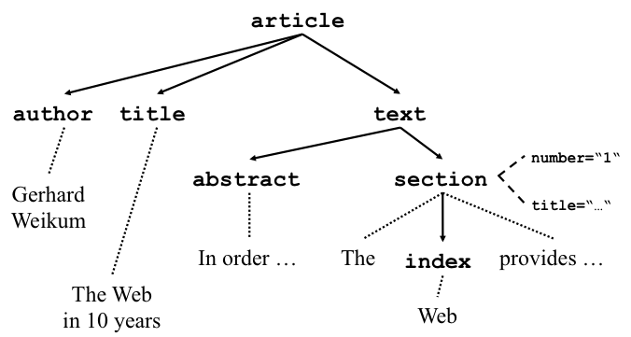
Ordered Tree

Slide 39
More on XML Syntax
Some special characters must be escaped using entities: < → &lt; & → &amp; (will be converted back when reading the XML doc)
Some other characters may be escaped, too: > → &gt; “ → &quot; ‘ → &apos;

Slide 40
Well-Formed XML Documents
A well-formed document must adher to, among others, the following rules:
Every start tag has a matching end tag.
Elements may nest, but must not overlap.
There must be exactly one root element.
Attribute values must be quoted.
An element may not have two attributes with the same name.
Comments and processing instructions may not appear inside tags.
No unescaped < or & signs may occur inside character data.

Slide 41
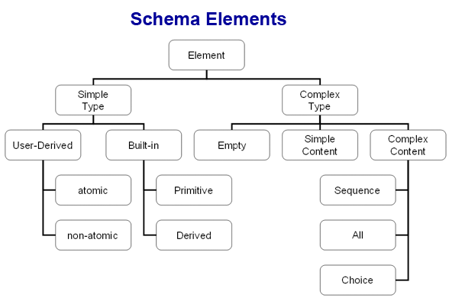
Schema
A XMLSchema describes the format of an XML document

Slide 42
The XSD document
Since the XSD is written in XML, it can get confusing which we are talking about
Except for the additions to the root element of our XML data document, the rest of this lecture is about the XSD schema document
The file extension is .xsd
The root element is <schema>
The XSD starts like this:
<?xml version="1.0"?> <xs:schema xmlns:xs="http://www.w3.rg/2001/XMLSchema">

Slide 43
<schema>
The <schema> element may have attributes:
xmlns:xs="http://www.w3.org/2001/XMLSchema"
This is necessary to specify where all our XSD tags are defined
elementFormDefault="qualified"
This means that all XML elements must be qualified (use a namespace)
It is highly desirable to qualify all elements, or problems will arise when another schema is added

Slide 44
“Simple” and “complex” elements
A “simple” element is one that contains text and nothing else
A simple element cannot have attributes
A simple element cannot contain other elements
A simple element cannot be empty
However, the text can be of many different types, and may have various restrictions applied to it
If an element isn’t simple, it’s “complex”
A complex element may have attributes
A complex element may be empty, or it may contain text, other elements, or both text and other elements

Slide 45
Defining a simple element
A simple element is defined as <xs:element name="name" type="type" /> where:
name is the name of the element
the most common values for type are xs:boolean xs:integer xs:date xs:string xs:decimal xs:time
Other attributes a simple element may have:
default="default value" if no other value is specified
fixed="value" no other value may be specified

Slide 46
Defining an attribute
Attributes themselves are always declared as simple types
An attribute is defined as <xs:attribute name="name" type="type" /> where:
name and type are the same as for xs:element
Other attributes a simple element may have:
default="default value" if no other value is specified
fixed="value" no other value may be specified
use="optional" the attribute is not required (default)
use="required" the attribute must be present

Slide 47
Restrictions, or “facets”
The general form for putting a restriction on a text value is:
<xs:element name="name"> (or xs:attribute) <xs:restriction base="type"> ... the restrictions ... </xs:restriction> </xs:element>
For example:
<xs:element name="age"> <xs:restriction base="xs:integer"> <xs:minInclusive value="0"> <xs:maxInclusive value="140"> </xs:restriction> </xs:element>

Slide 48
Restrictions on numbers
minInclusive -- number must be ≥ the given value
minExclusive -- number must be > the given value
maxInclusive -- number must be ≤ the given value
maxExclusive -- number must be < the given value
totalDigits -- number must have exactly value digits
fractionDigits -- number must have no more than value digits after the decimal point

Slide 49
Restrictions on strings
length -- the string must contain exactly value characters
minLength -- the string must contain at least value characters
maxLength -- the string must contain no more than value characters
pattern -- the value is a regular expression that the string must match
whiteSpace -- not really a “restriction”--tells what to do with whitespace
value="preserve" Keep all whitespace
value="replace" Change all whitespace characters to spaces
value="collapse" Remove leading and trailing whitespace, and replace all sequences of whitespace with a single space

Slide 50
Enumeration
An enumeration restricts the value to be one of a fixed set of values
Example:
<xs:element name="season"> <xs:simpleType> <xs:restriction base="xs:string"> <xs:enumeration value="Spring"/> <xs:enumeration value="Summer"/> <xs:enumeration value="Autumn"/> <xs:enumeration value="Fall"/> <xs:enumeration value="Winter"/> </xs:restriction> </xs:simpleType> </xs:element>

Slide 51
Complex elements
A complex element is defined as <xs:element name="name"> <xs:complexType> ... information about the complex type... </xs:complexType> </xs:element>
Example: <xs:element name="person"> <xs:complexType> <xs:sequence> <xs:element name="firstName" type="xs:string" /> <xs:element name="lastName" type="xs:string" /> </xs:sequence> </xs:complexType> </xs:element>
<xs:sequence> says that elements must occur in this order
Remember that attributes are always simple types

Slide 52
Global and local definitions
Elements declared at the “top level” of a <schema> are available for use throughout the schema
Elements declared within a xs:complexType are local to that type
Thus, in <xs:element name="person"> <xs:complexType> <xs:sequence> <xs:element name="firstName" type="xs:string" /> <xs:element name="lastName" type="xs:string" /> </xs:sequence> </xs:complexType> </xs:element> the elements firstName and lastName are only locally declared
The order of declarations at the “top level” of a <schema> do not specify the order in the XML data document

Slide 53
Declaration and use
So far we’ve been talking about how to declare types, not how to use them
To use a type we have declared, use it as the value of type="..."
Examples:
<xs:element name="student" type="person"/>
<xs:element name="professor" type="person"/>
Scope is important: you cannot use a type if is local to some other type

Slide 54
xs:sequence
We’ve already seen an example of a complex type whose elements must occur in a specific order:
<xs:element name="person"> <xs:complexType> <xs:sequence> <xs:element name="firstName" type="xs:string" /> <xs:element name="lastName" type="xs:string" /> </xs:sequence> </xs:complexType> </xs:element>

Slide 55
xs:all
xs:all allows elements to appear in any order
<xs:element name="person"> <xs:complexType> <xs:all> <xs:element name="firstName" type="xs:string" /> <xs:element name="lastName" type="xs:string" /> </xs:all> </xs:complexType> </xs:element>
Despite the name, the members of an xs:all group can occur once or not at all
You can use minOccurs="0" to specify that an element is optional (default value is 1)
In this context, maxOccurs is always 1

Slide 56
Referencing
Once you have defined an element or attribute (with name="..."), you can refer to it with ref="..."
Example:
<xs:element name="person"> <xs:complexType> <xs:all> <xs:element name="firstName" type="xs:string" /> <xs:element name="lastName" type="xs:string" /> </xs:all> </xs:complexType> </xs:element>
<xs:element name="student" ref="person">
Or just: <xs:element ref="person">

Slide 57
Text element with attributes
If a text element has attributes, it is no longer a simple type
<xs:element name="population"> <xs:complexType> <xs:simpleContent> <xs:extension base="xs:integer"> <xs:attribute name="year” type="xs:integer"> </xs:extension> </xs:simpleContent> </xs:complexType> </xs:element>

Slide 58
Empty elements
Empty elements are (ridiculously) complex
<xs:complexType name="counter"> <xs:complexContent> <xs:extension base="xs:anyType"/> <xs:attribute name="count" type="xs:integer"/> </xs:complexContent> </xs:complexType>

Slide 59
Mixed elements
Mixed elements may contain both text and elements
We add mixed="true" to the xs:complexType element
The text itself is not mentioned in the element, and may go anywhere (it is basically ignored)
<xs:complexType name="paragraph" mixed="true"> <xs:sequence> <xs:element name="someName” type="xs:anyType"/> </xs:sequence> </xs:complexType>

Slide 60
Extensions
You can base a complex type on another complex type
<xs:complexType name="newType"> <xs:complexContent> <xs:extension base="otherType"> ...new stuff... </xs:extension> </xs:complexContent> </xs:complexType>

Slide 61
Predefined string types
Recall that a simple element is defined as: <xs:element name="name" type="type" />
Here are a few of the possible string types:
xs:string -- a string
xs:normalizedString -- a string that doesn’t contain tabs, newlines, or carriage returns
xs:token -- a string that doesn’t contain any whitespace other than single spaces
Allowable restrictions on strings:
enumeration, length, maxLength, minLength, pattern, whiteSpace

Slide 62
Predefined date and time types
xs:date -- A date in the format CCYY-MM-DD, for example, 2002-11-05
xs:time -- A date in the format hh:mm:ss (hours, minutes, seconds)
xs:dateTime -- Format is CCYY-MM-DDThh:mm:ss
The T is part of the syntax
Allowable restrictions on dates and times:
enumeration, minInclusive, minExclusive, maxInclusive, maxExclusive, pattern, whiteSpace

Slide 63
Here are some of the predefined numeric types:
xs:decimal xs:positiveInteger
xs:byte xs:negativeInteger
xs:short xs:nonPositiveInteger
xs:int xs:nonNegativeInteger
xs:long
Allowable restrictions on numeric types:
enumeration, minInclusive, minExclusive, maxInclusive, maxExclusive, fractionDigits, totalDigits, pattern, whiteSpace

Slide 64
Resources
http://www.w3schools.com/xml/default.asp
http://www.w3schools.com/schema/default.asp
http://www.xmlblueprint.com/

Slide 65


cloud

Slide 66
SOAP
Simple Object Access Protocol
Takes advantage of XML Namespace and XML Schema
Web Service messaging and invocation
SOAP is the envelope that contains the message
WSDL is the description of the service

Slide 67
SOAP
<?xml version="1.0" encoding="UTF-8"?>
<Envelope>
<Header>
</Header>
<Body>
</Body>
</Envelope>

Slide 68
SOAP Header
Optional
Allows packaging of information orthogonal to message
Transactions
Authentication information
Account information
SOAP-ENV:mustUnderstand

Slide 69
SOAP-ENV:mustUnderstand
Attribute for Header element
Value 0 – skip this element if it doesn’t make sense
Value 1 – must fail if it doesn’t make sense
Ensures recipients be aware of important protocol extensions
<SOAP-ENV:Header>
<t:client xmlns:t=“Some-URI”
SOAP-ENV:mustUnderstand=“0”>
sacharya@inktomi.com
</t:client>
</SOAP-ENV:Header>

Slide 70
SOAP Body
Can contain arbitrary XML
Conventions for
RPCs
Faults
Faultcode – lookup string
Faultstring – human readable string
Faultactor – where in the message path
Detail – optional
Data encoding

Slide 71
Data encoding in SOAP
SOAP provides default encoding schema
Why reinvent the wheel?
Simple data types
Use “xsi:type”
String, floats etc
Complex data types
SOAP arrays
Structs: compound types
Data referencing
Href and id attributes

Slide 72
Data encoding in SOAP
Binary data
Base64 encoding
Can roll your own schema
encodingStyle
Interoperability issues

Slide 73
Where does WSDL fit?
SOAP is the envelope containing the message
WSDL describes the service
UDDI is a listing of web services described by WSDL
Notes:
UDDI is the “yellow pages” of web services

Slide 74
Document Structure
Written in XML
Two types of sections
Abstract and Concrete
Abstract sections define SOAP messages in a platform- and language-independent manner
Site-specific matters such as serialization are relegated to the Concrete sections

Slide 75
Abstract Definitions
Types: Machine- and language-independent type definitions.
Messages: Contains function parameters (inputs are separate from outputs) or document descriptions.
PortTypes: Refers to message definitions in Messages section that describe function signatures (operation name, input parameters, output parameters).

Slide 76
Concrete Descriptions
Bindings: Specifies binding(s) of each operation in the PortTypes section.
Services: Specifies port address(es) of each binding.

Slide 77
Operation
An operation is similar to a function in a high level programming language
A message exchange is also referred to as an operation
Operations are the focal point of interacting with the service

Slide 78
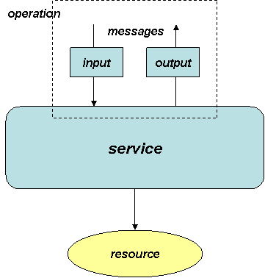
Big Picture

Slide 79
An Example
<?xml version="1.0" encoding="UTF-8" ?>
This first line declares the document as an XML document.
Not required, but helps the XML parser determine whether to parse the file or signal an error
Notes:
Refer to handout

Slide 80
Types Section
The type element defines the data types that are used by the web service.
<xsd:complexType name="PERSON"> <xsd:sequence> <xsd:element name="firstName“ type="xsd:string"/> <xsd:element name="lastName" type="xsd:string"/> <xsd:element name="ageInYears" type="xsd:int"/> </xsd:sequence> </xsd:complexType>

Slide 81
Messages Section
A message element defines parameters
The name of an output message element ends in "Response" by convention
<message name="Simple.foo"> <part name="arg" type="xsd:int"/> </message> <message name="Simple.fooResponse"> <part name="result" type="xsd:int"/> </message>

Slide 82
PortTypes Section
Defines a web service, the operations that can be performed, and the messages that are involved.
<portType name="SimplePortType"> <operation name="foo" parameterOrder="arg" > <input message="wsdlns:Simple.foo"/> <outputmessage="wsdlns:Simple.fooResponse"/> </operation> </portType>

Slide 83
Bindings Section
The binding element defines the message format and protocol details for each port.
<operation name="foo"> <soap:operation soapAction="http://tempuri.org/action/Simple.foo"/> <input> <soap:body use="encoded" namespace="http://tempuri.org/message/" encodingStyle="http://schemas.xmlsoap.org/soap/encoding/" /> </input> <output> <soap:body use="encoded“ namespace="http://tempuri.org/message/“ encodingStyle="http://schemas.xmlsoap.org/soap/encoding/" /> </output> </operation>
Notes:
Refer to handout

Slide 84
The Port Element
Each <port> element associates a location with a <binding> in a one-to-one fashion
<port name="fooSamplePort" binding="fooSampleBinding"> <soap:address location="http://carlos:8080/fooService/foo.asp"/> </port>

Slide 85
Services Section
A collection of related endpoints, where an endpoint is defined as a combination of a binding and an address
<service name="FOOSAMPLEService"> <port name="SimplePort“ binding="wsdlns:SimpleBinding"> <soap:address location="http://carlos:8080/FooSample/ FooSample.asp"/> </port> </service>

Slide 86
An Example
<message name="Simple.foo"> <part name="arg" type="xsd:int"/> </message> <message name="Simple.fooResponse"> <part name="result" type="xsd:int"/> </message>
<portType name="SimplePortType"> <operation name="foo" parameterOrder="arg" > <input message="wsdlns:Simple.foo"/> <output message="wsdlns:Simple.fooResponse"/> </operation> </portType>
The above describes what kind of C/C++ function call?
int foo(int arg);

Slide 87
SOAP-UI
Homework Resources
WSDL Tutorial: http://tutorials.jenkov.com/wsdl/index.html
XML Tutorial http://www.w3schools.com/xml/default.asp
Schema Tutorial http://www.w3schools.com/schema/
SOAP-UI: http://sourceforge.net/projects/soapui/files/soapui/5.0.0/SoapUI-5.0.0.dmg/download http://sourceforge.net/projects/soapui/files/soapui/5.0.0/SoapUI-x64-5.0.0.exe/download
SOAP-UI Tutorial: http://www.soapui.org/Getting-Started/your-first-soapui-project.html

Slide 88
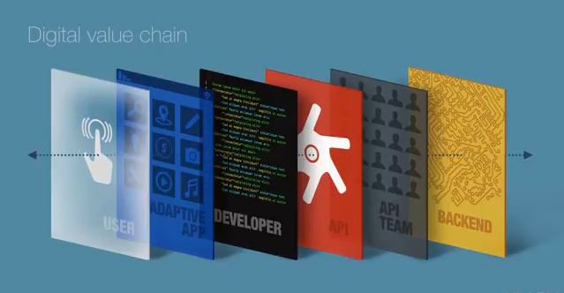
What is the outside world doing?
“We will unlock the hidden value of assets, and participate in the digital currency ecosystem when we focus on mobile and API first initiatives.”
* Courtesy of Apigee

Slide 89
Developers Key to Digital
Transform into digital business
Unlocking value through APIs
API Management and analytics
Empower developers
Changing market approach to customer experience driving product development
Moving to a product centric delivery
Viewing API as technology that empowers innovation and creativity of the organization
Notes:
Major shift to transform into digital business.
Unlocking value by exposing hidden assets (through APIs).
Standardizing on method (API Management and analytics) to expose and access hidden assets.
Empower the developers. Internal/external developers treated the same way.
Changing market approach from inside-out view (specific functional products) to an outside-in approach with the customer experience driving product development.
Moving to a product centric delivery rather than today’s functional teams. Allow organizations to respond quicker to market opportunities.
No longer viewing technology as a cost reducing mechanism but something empowers innovation and creativity of the organization e.g. first to market higher priority than reducing cost by x %.

Slide 90
Why APIs? Why Now?
Hide our complexity to provide an Omni-channel experience
Reduce time to market of new solutions for both Vantiv and our clients
Enable innovation by providing the right building blocks to create unique solutions
Put the developer first is aligned with a digital strategy
A common entry point (APIs) enables actionable analytics
Increased stickiness & reuseability

Slide 91

Digital Transformation
“Wrapping APIs around their stores.”
Customers who engage with Walgreens in person, online and via mobile apps spend 6 times more than those that only visit the stores (over 150 developer partners using their omnichannel strategy).
“At the highest level, we've always been focused on giving our customers the ability to interact with Walgreens through a number of different channels, and this has evolved over time,” said Joe Rago, senior mobile product manager at Walgreens.
Delivering an open API to foster a broad array of third-party apps that leveraged Walgreens services was a natural next step and one that enabled Walgreens to take advantage of mobile trends, as well as mitigate an internal business problem.
Reference: http://apigee.com/about/customer-story/walgreens-putting-api-around-their-stores

Slide 92

Digital Transformation
Transforming banking architecture to be API centric and is demanding all their interactions with partners to be API centric.
“Changing banking for good”

Slide 93
API Journey
A portal with all the necessary information and tools (including automated certification) allowing a developer integrating with Vantiv to be as productive as possible reducing time to market.
An API management system helping Vantiv to quickly expose and normalize existing and new services for developers (internal/external) to consume.

Slide 94
Building Blocks for Transformation
Standardized authentication model using ForgeRock.
Developer Portal
Developer dashboards
Online developer centric documentation
Community (forums)
Developer Engagement Analytics
Sample code (.Net, Java, PHP, Python)
Instant access to test environment

Slide 95
Building Blocks for Transformation
API Management Platform
Designed to allow teams to quickly expose SOAP based web services as Restful APIs
PWS and Element’s Express Gateway implemented as Restful APIs
API façade
Normalized APIs
Real-time transaction policies
Ability to centrally monitor and manage APIs
Scoping and certification validation engine
Supports self service integrations
Test driven development with real time feedback

Slide 96

API Journey
Create an industry leading repository of APIs, associated documentation and tools supporting an active developer ecosystem while managing the API lifecycle, governing API usage/traffic, providing monitoring and reporting for the APIs and the integrated applications to help grow the developers’ application user base.

Slide 97
Developer Ecosystem Feature Backlog
Automated Underwriting and Boarding
Expose Underwriting (to access FICO) and Boarding
Support Payfac model e.g. underwrite and activate sub-merchants automatically.
Implement Swagger 2.0 support
Add Swagger 2.0 support to Smartdocs
Card Services
Expose card service API
Supports CapitalOne opportunity
Transaction Reporting API
Expose reporting API to developers who would like to embed in their applications. Payfacs are good example
PWS Sandbox
Implement PWS Sandbox capabilities within Developer Ecosystem.
Eliminate need to submit transactions to test host environment.
PWS EMV
Expose EMV support for PWS
Dependent upon EMV readiness in PWS
Live Chat Support
Salesforce.com
Portal will expose APIs to allow certified developers to provide auto underwriting and activation of PWS merchants
Cert Analyst support of developer
Automate lead creation
Notification of certification progress

Slide 98
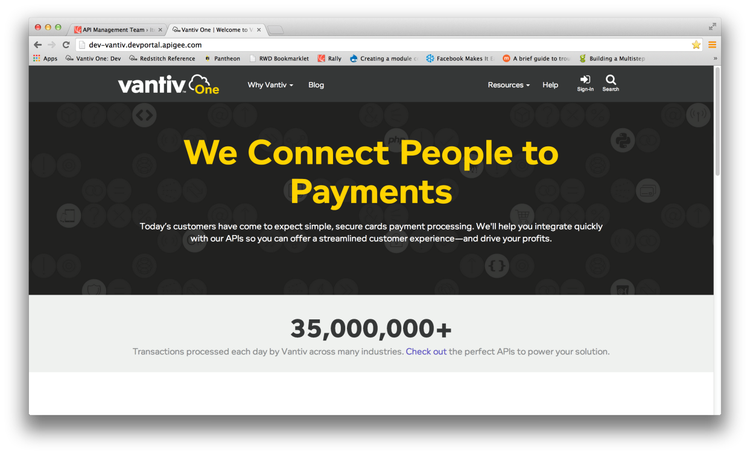
Developer Portal

Slide 99
A Technology Evolution
API as a Product
Drive developer adoption
APIs that are easy to understand with clear helpers and samples
Agility
API ecosystem that supports exposing our set of API’s in multiple ways (SOAP, REST, etc)
Ecosystem
Develop and grow strong ecosystem of partners who can help each other through forums and solution idea sections

Slide 100
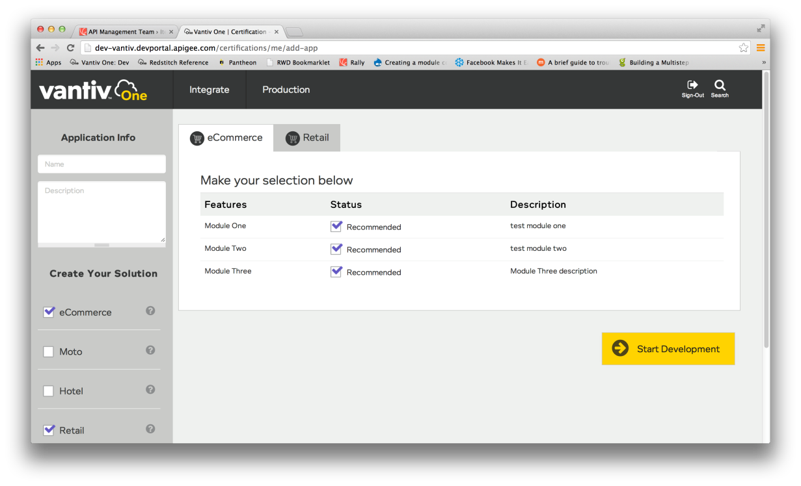
Parameter-Driven Development

Slide 101
Portal Goals
From one portal get access to all APIs
Learn how to use each interface and interact with them in real-time before writing one line of code
Select features that are important to your solution
Drive content relevant to the developer

Slide 102
Why?
“Create new sources of value for customers and increase operational agility in service of customers.” —Nigel Fenwick Forrester
Set of assets add more value when combined
Example: intelligent mobile app leveraging stream of data to adjust to user behavior. Just purchased oreos and as a result serves up discount on milk.
Allows developer community to innovate and create new business models not thought of by the organization exposing the digital asset.
Standardized method to expose assets, e.g., API management platform, allows internal developers to respond quicker to market opportunities.

Slide 103
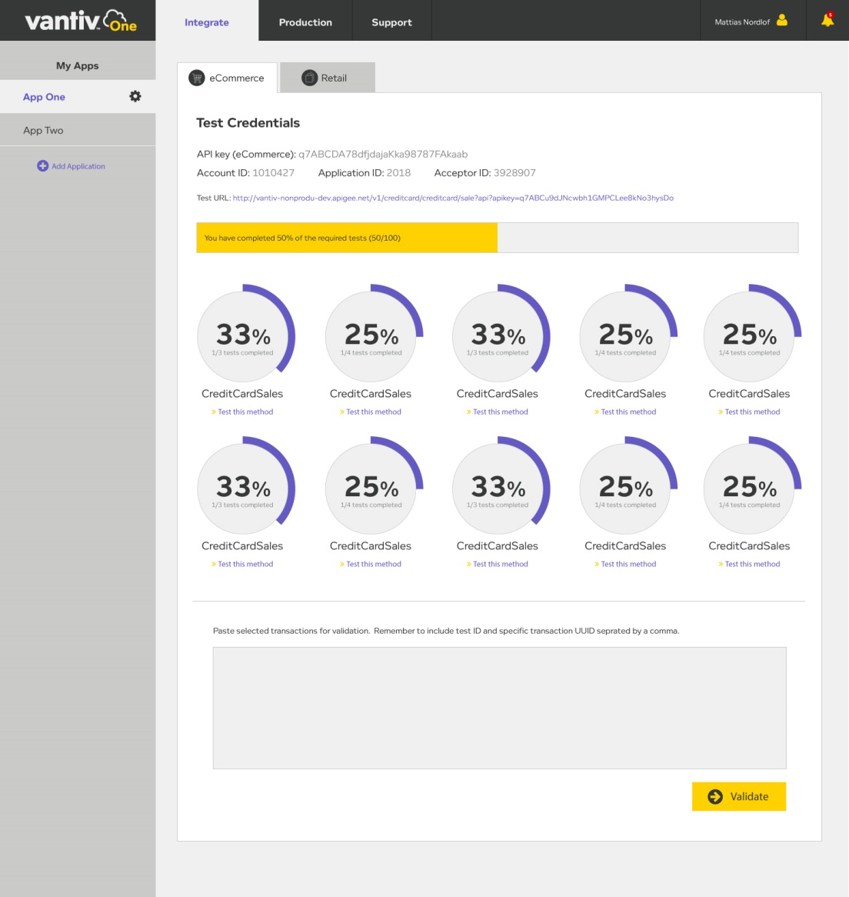
Automating Certification and Analysis
Automating certifications of API integrations
Allow developers to streamline their integrations
Provides feedback and analytics to developer
Insights in process and sales engineering engagement
Find out in real-time how your API calls to Vantiv are measuring

Slide 104
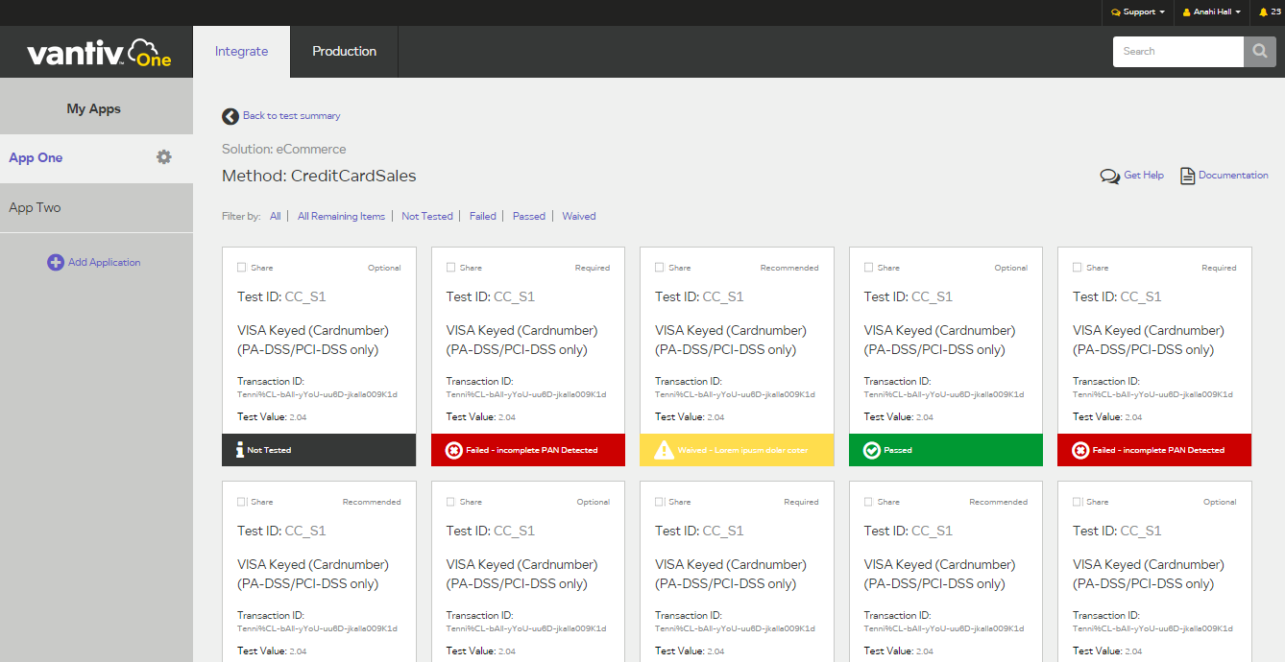
Test-Driven Development

Slide 105
Speed to Integration
Manage your integration effort in detail.
Focus on what is critical.
Share test cases or issues with your team directly from the portal.

Slide 106
Developer: How Can Developer Ecosystem Help Me?
Reduce time to market (quicker integrations)
Allows me to self service
Access to online documentation with embedded sample code, standalone sample code leveraging Github, forums, test environment and self-service certification.
Integration and Production Analytics giving me insight to how my application is performing.

Slide 107
Diverse Sample Code
Majority of sample code supporting Restful APIs
Support developers across the languages they use
Excluding groups is what led to RESTful APIs
API
PHP
Node.js
Python
Ruby
.Net
Android SDK
Objective C / Swift
Java
Javascript

Slide 108
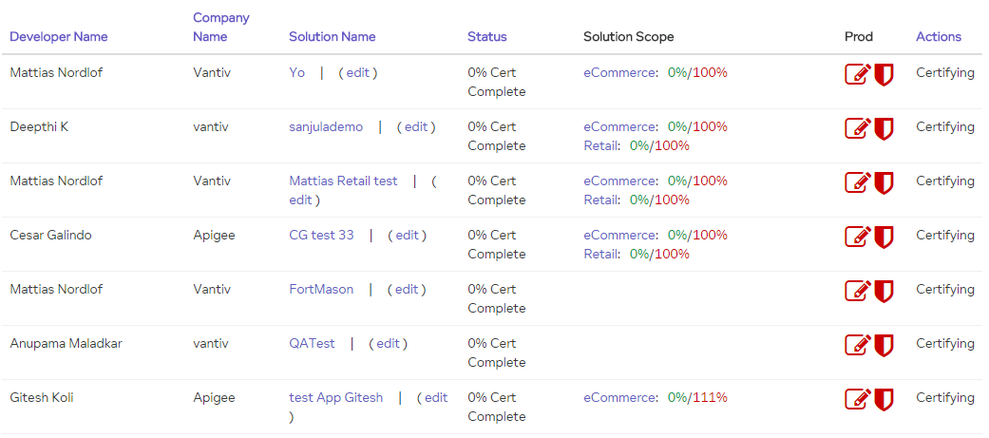
Cert Analyst: How Will Developer Ecosystem Help?

Slide 109
Cert Analyst Benefits
Ability to create, edit and publish appropriate certification suites to developers.
Flexible certification test criteria which can be leveraged across different types of APIs.
Notifications triggered based upon certification progress allowing me to focus on what is important e.g. assisting developers that need help.
Centralized dashboard displaying ongoing certifications.

Slide 110
Certification Test Criteria
Value Comparison Operators
Equal to
Not equal to
Greater than
Greater than or equal to
Less than
Less than or equal to
Starts with Type
Expression Comparison
Regular Expression
Compare using Relate
Element Comparison
Exists
Not exists in elements
Compare using SUM
Compare using LIST
Not Exists
Select element value
Test Suites developed around API solutions

Slide 111
Current Transaction Policies
Prevent test MID/TID from being used in Production
Prevent test cards from being used in Production
Spike arrest – prevent someone from sending in 10 million transactions at once.
Verify API Key – only approved applications can access the endpoints to transact.
Payload missing or bad formatted payload
Invalid content type check
JSON and XML threat protection
Logging – to feed into Splunk
Validate required fields associated with a transaction e.g. Authorize or Sale

Slide 112
Developer Ecosystem SETI Team Benefits

Slide 113
SETI Team Benefits
Automated certification support.
Custom certifications can be exposed to support specific opportunities.
Central location for insights and certification tracking.
Salesforce.com integration for lead and opportunity tracking.
Automated notifications of important events throughout the developer engagement e.g. 1st test transaction submitted or Certification completed.
Automated scoping process.

Slide 114
What’s Next?
Provide all current and future APIs in Dev Eco starting with:
Card Services APIs – in support of CapitalOne RFP
Underwriting API and Boarding API
Transaction Reporting API
Drive all API consumption through Dev Eco

Slide 115
What’s Next?
Continue to leverage Dev Eco to enhance PWS experience
Enhance certification process
Improved analytics
Interactive documentation (Swagger 2.0 support)
Expose more PWS features (Gift, EMV, OmniToken, etc.)
Salesforce.com integration
Live chat support
Full continuous integration and deployment

Slide 116
Roadmap
Q1-15
eCommerce
Retail
Q2-15
Card Services
Boarding
Q3-15
Chargeback
Document Management
Q4-14
Tandem
Restaurant
Tokenization
Underwriting
Terminal Management
Dispute
Notifications
Fraud
Research/Reporting (FI)
Research/Reporting (FI)
Certification
Sample Code
Analytics
Portal Launch

Slide 117
The Developer is our Target Market
Developer*
API Façade
Documentation
Portal
API Explorer
Good definition of error codes
Helps the developer:
How do I sign-up, Get Started, Use It and Get Help
Offering API as a service
Consistent APIs /Common Request – Response
Easy to understand naming conventions
Single format to understand
Well understood and common authorization/authentication model
Authentication and Authorization / Basic / Oauth and ability to test and verify auth
Understand API within console
Documentation based on domain
Defined errors and how to deal with them
Helps the developer:
Interactive Documentation
Provides Clarity, Cost and Community
Reporting, Management, dashboard
Self manage application, analytics and reports
Helps the developer:
Auto registration of application and key
Sample code in the language I care about
Sample Code
Forums and community to interact
Provides necessary feedback to assist the developer
Manage the certification process
Helps the developer
Sales Force Integration / Providing common CRM
Insights in process / allowing sales engineer to engage (I see you at 50% how can I help)
Automating certification / allowing developer to streamline their process
Certification

Slide 118
Developer Ecosystem Features

Slide 119
cloud

